Slide 1
Scope and Life time
1. Scope
Meaning: Region where a variable can be access. (i.e., where its name is valid).
Types in C:
Block scope: Inside { } (local variables).
Function scope: Labels inside a function.
File scope: Declared outside all functions (global).
Function prototype scope: Parameters declared inside function prototypes.

Slide 2
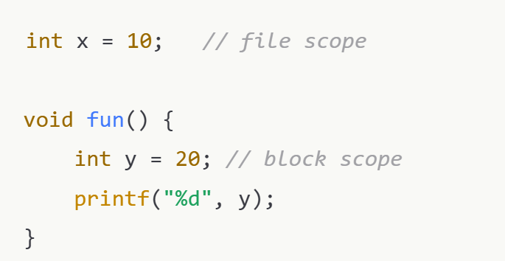

Slide 3
Lifetime
Meaning: How long a variable exists in memory during execution.
Local variables: auto int I; Exist only while the block/function is active (destroyed when function exits).
Static variables: Exist for the entire program run, retain value between function calls.
Dynamic variables: Exist until explicitly freed (malloc/free).

Slide 4
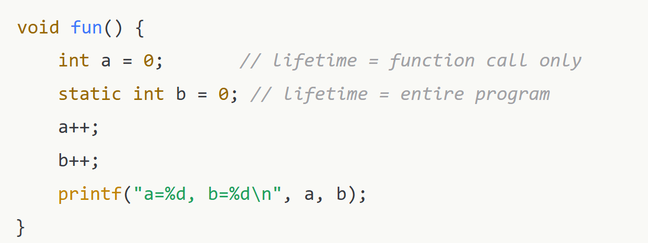
void fun() {
int a = 0; // lifetime = function call only
int b = 0; // lifetime = entire program
a++;
b++;
printf("a=%d, b=%d\n", a, b);
}

Slide 5
Storage classes
In C language, storage classes are keywords that define the scope and lifetime of variables/functions.
They tell the compiler where to store a variable, how long to keep it, and who can access it.

Slide 6
The 4 main storage classes in C are:
auto
register
static
extern

Slide 7
Automatic (auto)
auto int i=0;
Default used for local variables inside functions.
Variables are created when function is called and destroyed when function ends.
Stored in stack memory.
Scope → Local to the block.
Lifetime → During function execution only.

Slide 8
int main() {
auto int x = 10; // auto is optional
printf("x = %d\n", x); return 0;
}

Slide 9
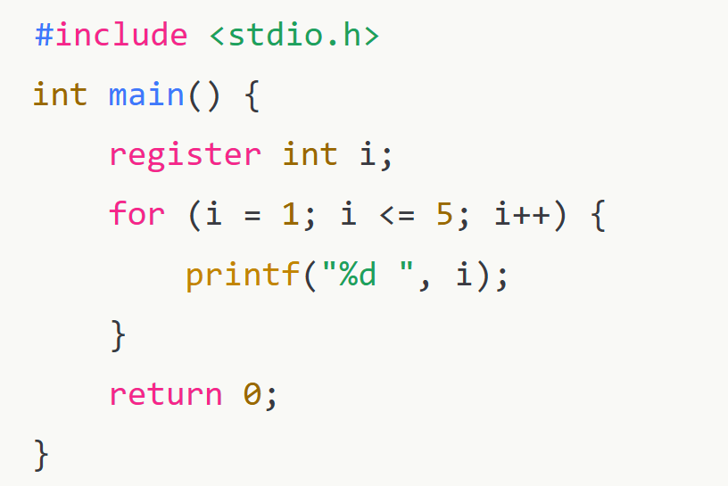
Register
Requests the compiler to store variable in CPU register (faster access).
Cannot get the address of a register variable using &.
Scope → Local to the block.
Lifetime → During function execution only.
Used for variables that need fast access (like loop counters).

Slide 10
Static : static int c=1;
Tells the compiler to keep a variable in memory for the entire program (not destroyed after function ends).
Default value = 0 (if not initialized).
Local static variable → Scope is within function, but value is retained across function calls.
Global static variable/function → Scope is restricted to the file (not accessible from other files).

Slide 11
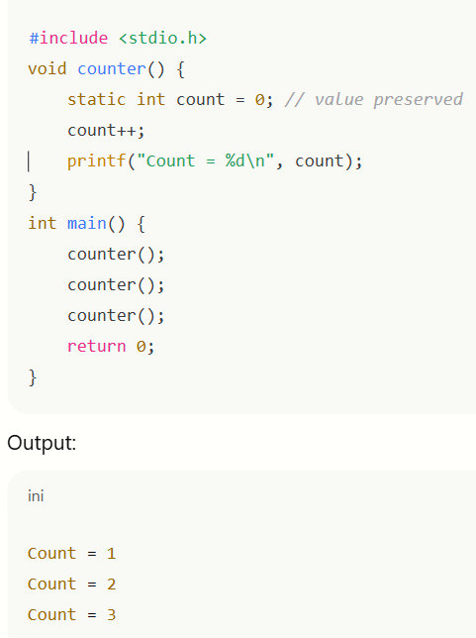

Slide 12
Extern
Extern int I;
Used to declare a global variable defined in another file or scope.
Gives reference to a global variable without creating storage.
Lifetime → Entire program.
Scope → Global.

Slide 13
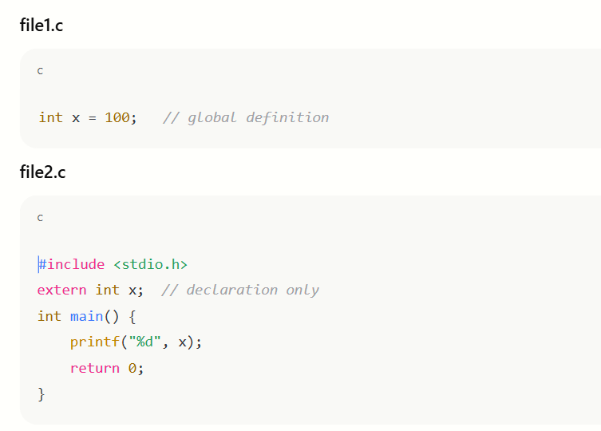

Slide 14
